Slide 1
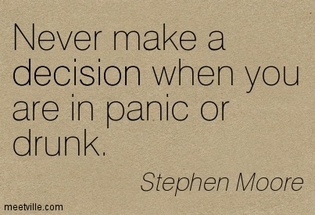

Slide 2
DrUNk TEST
A Targeted approach to combating alcohol abuse
Aimed at successful segregation of those under the influence and those who aren’t.
Interactive and brain teasing in equal measure, It aims to be a one stop approach to pinpointing excessive alcohol intake.

Slide 3
FEATURES

Slide 6
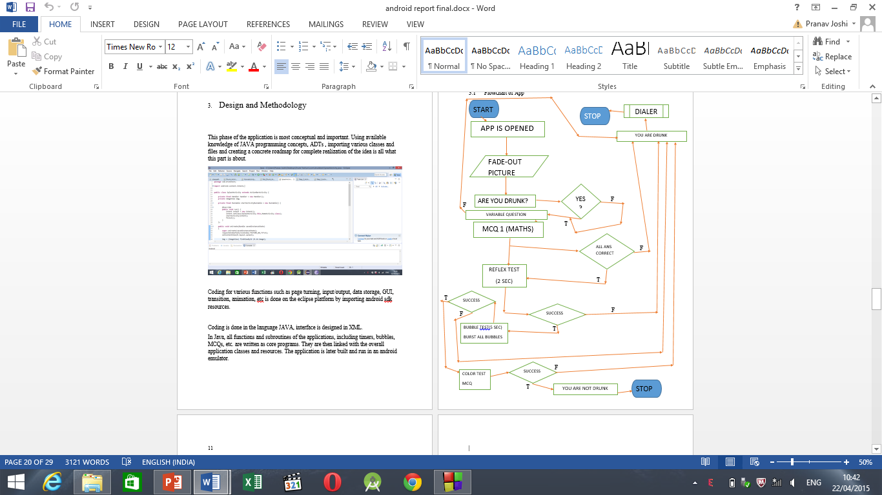

Slide 7
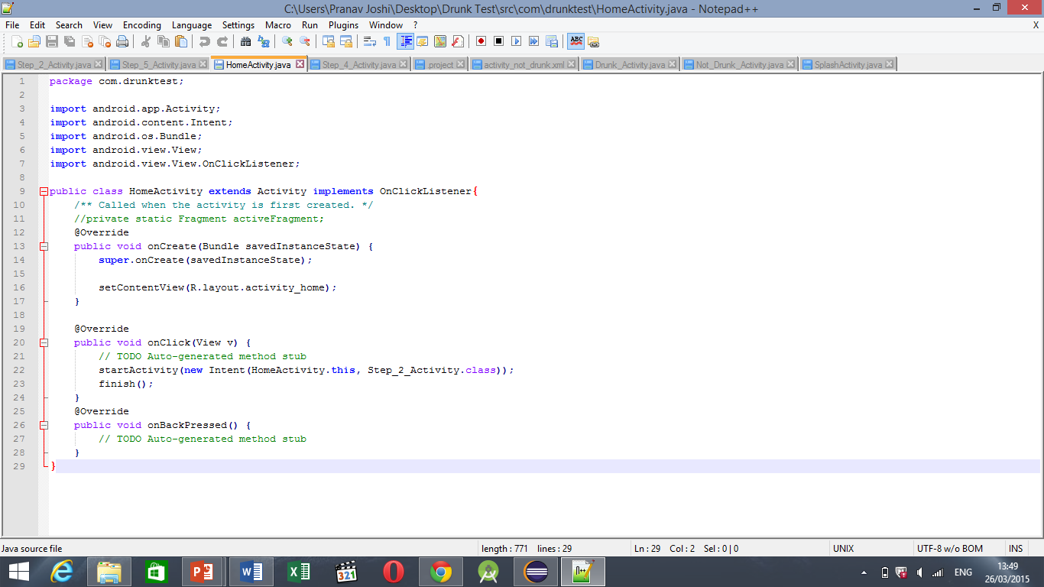
home page activity

Slide 8
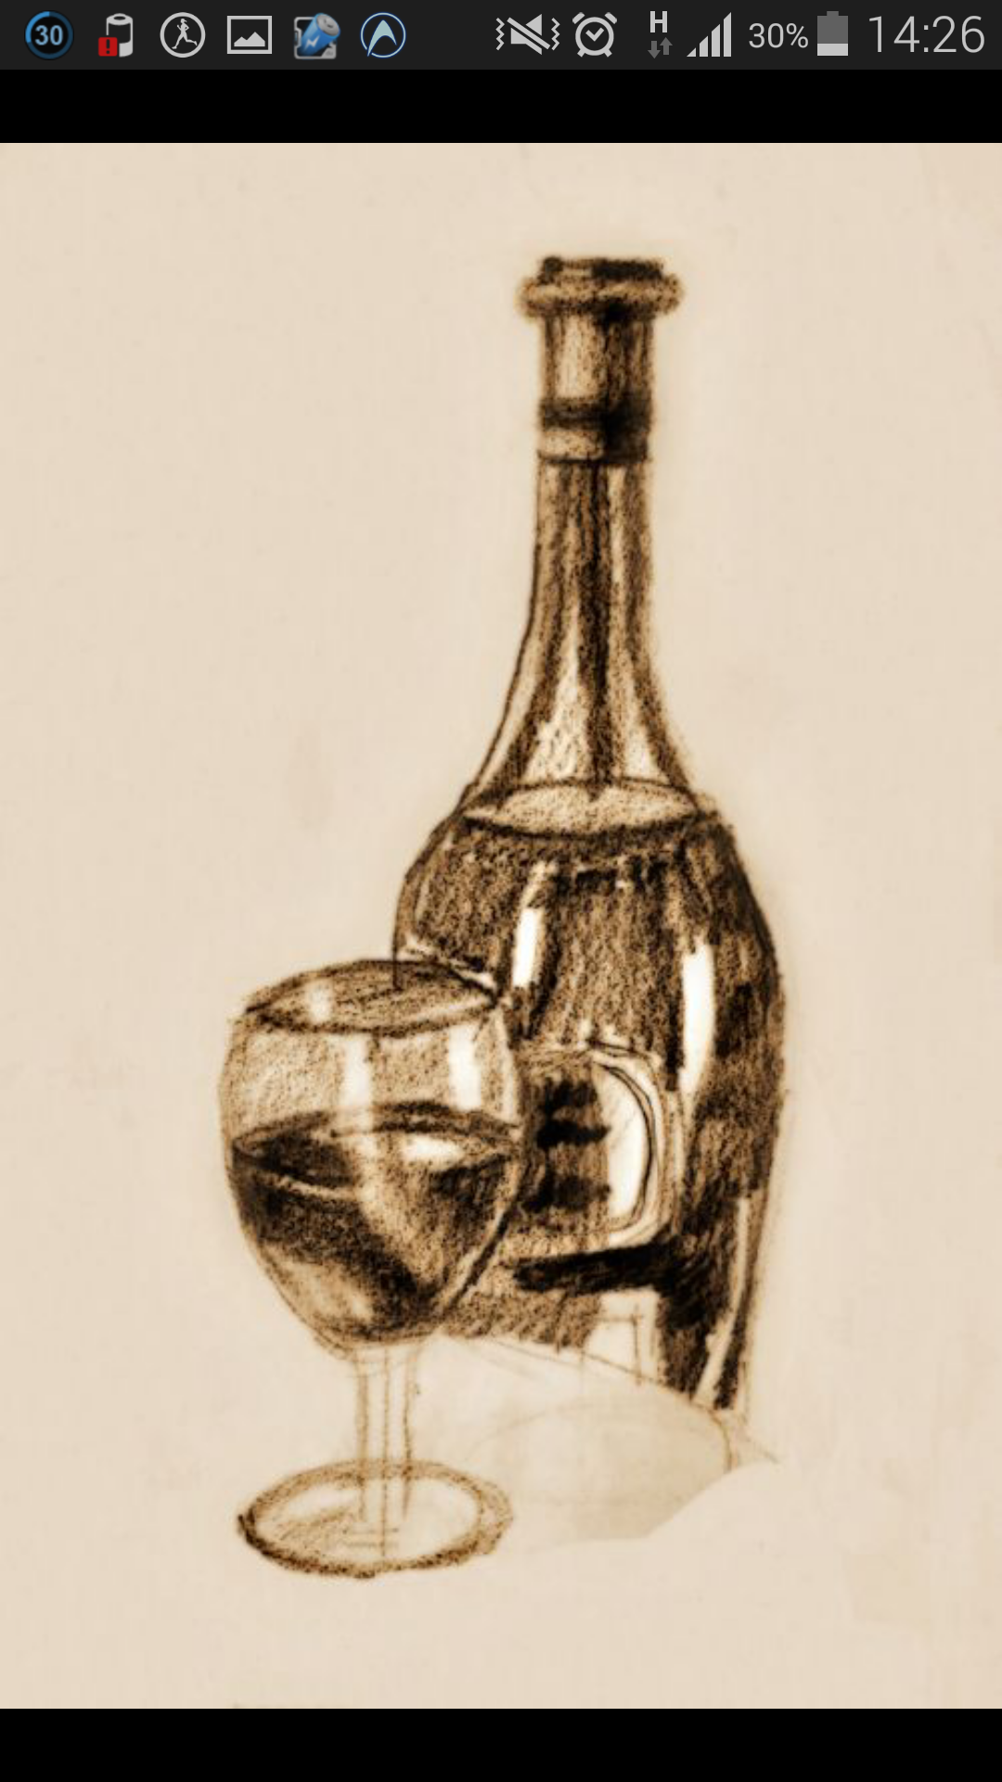
Adding the cover image as the logo of the app. The sepia image is sourced from the web and a fade-in fade out feature is added in Image view .This improves the aesthetic appeal of the application.

Slide 9
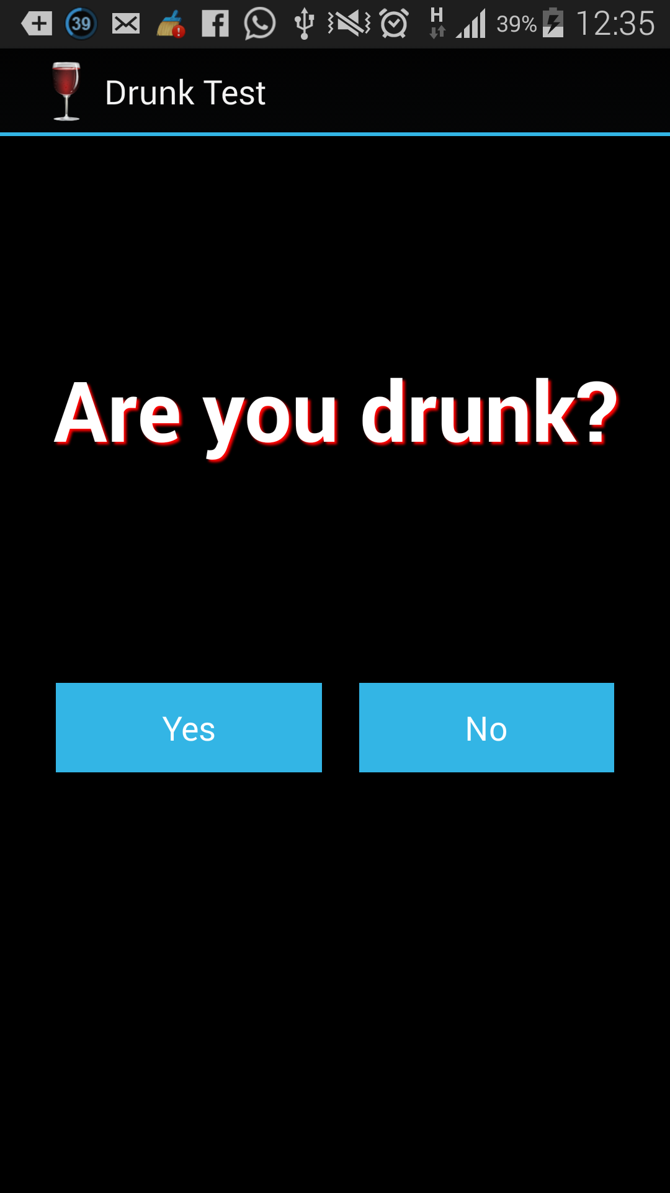
Screen one ACtIVITY 1. Are you Drunk? (YES\NO)

Slide 10
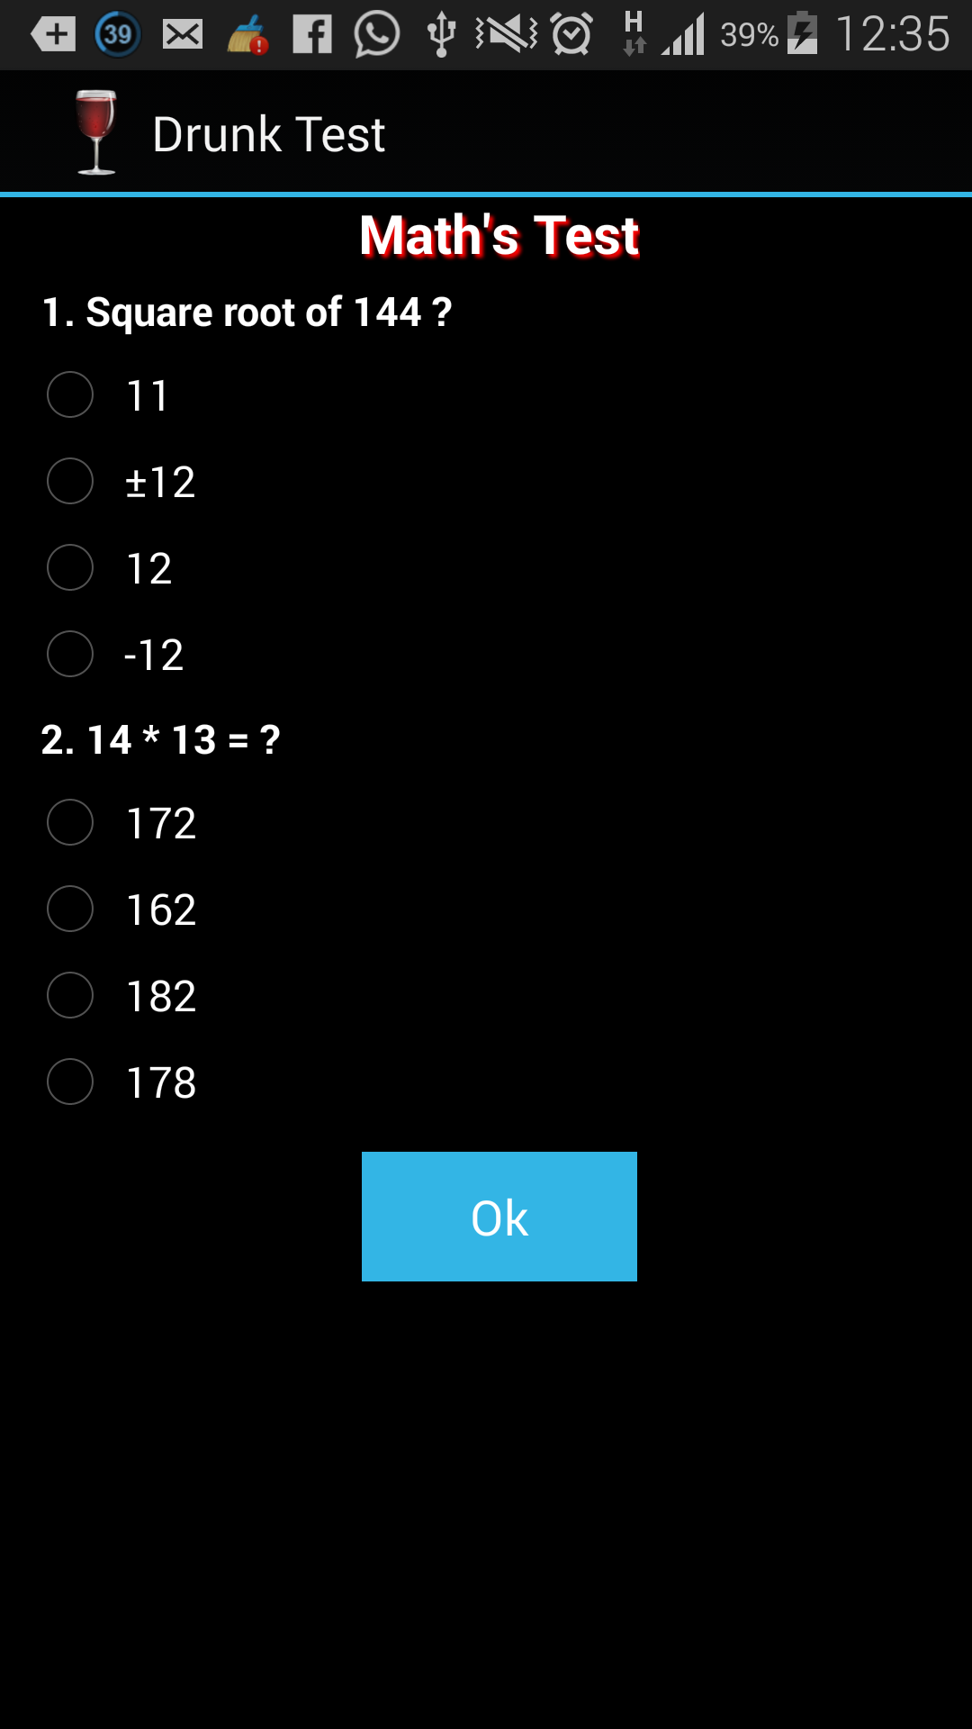
Screen two And 2nd activity. MATH’s Test. Answer Both the ques. According to your understanding level. { Toast.makeText(Step_2_Activity.this, "Answer both questions above !", Toast.LENGTH_LONG).show(); }

Slide 11
Screen 2 cont. 2nd test checks the reflexes of the user.

Slide 12
Dynamism

Slide 13
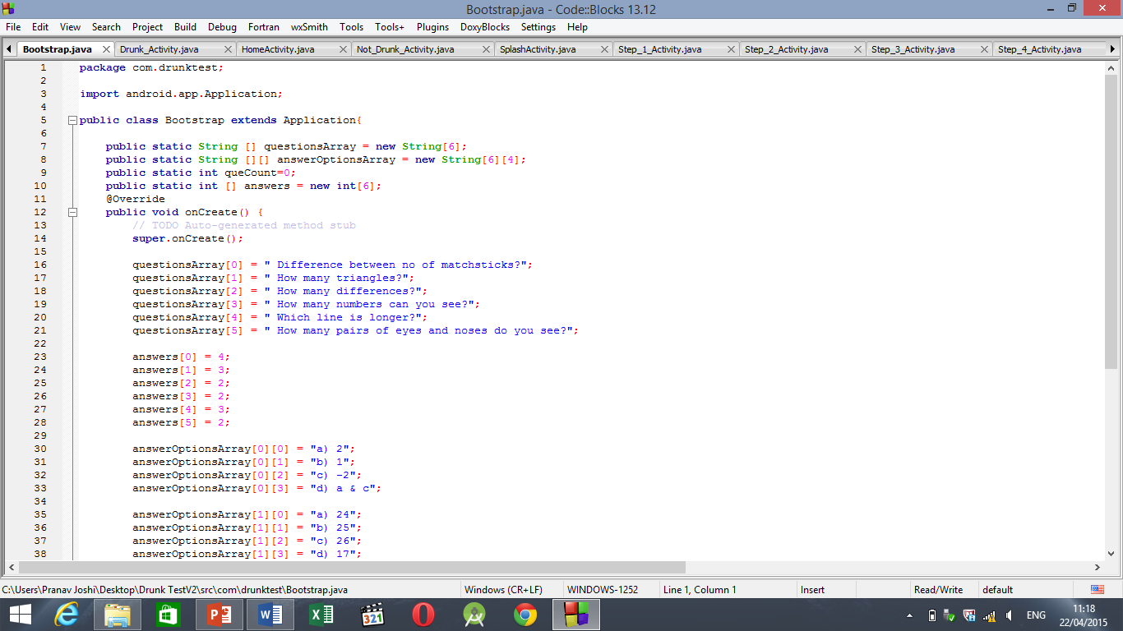

Slide 14
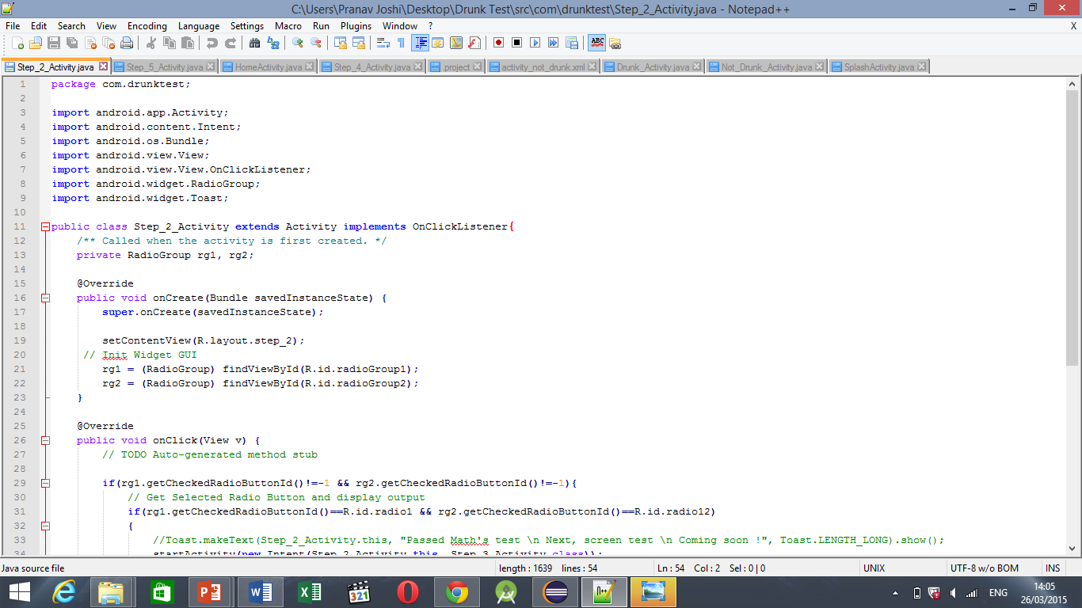

Slide 15
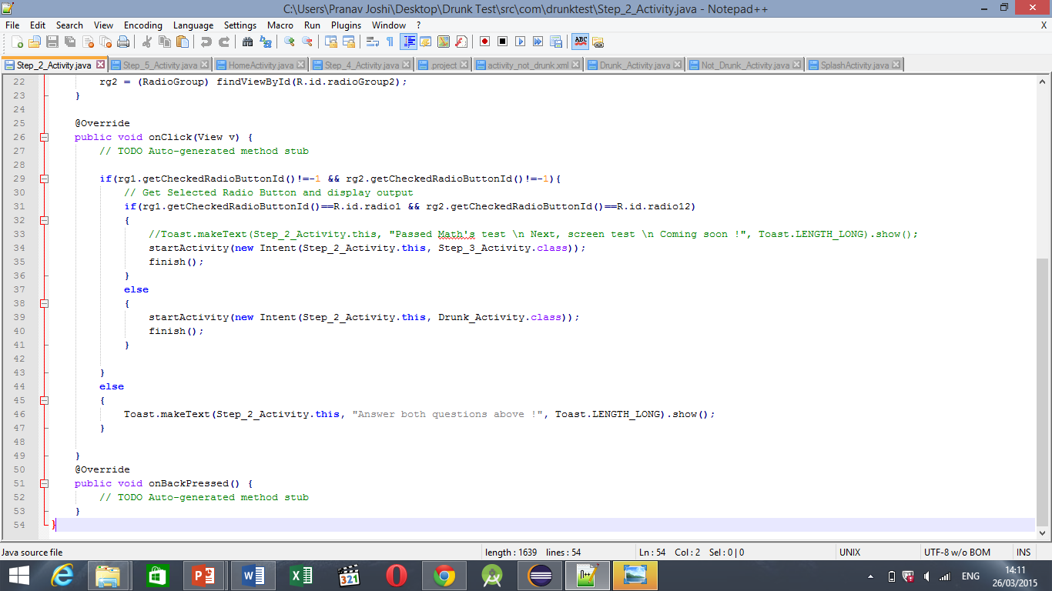

Slide 16
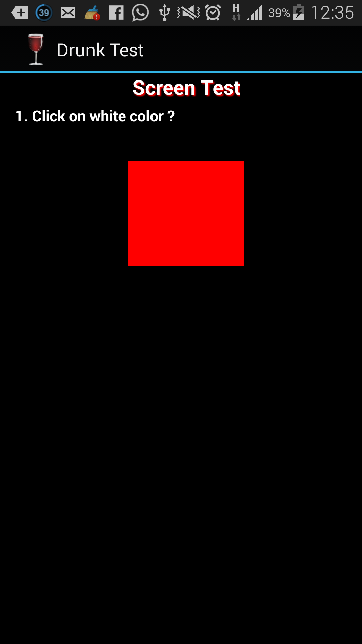
Screen 3 and test 2 Activity 3, Testing color Identification and reflexes.

Slide 17
On the screen there is a tile of red color , which keeps on changing within the time duration of 1 second. The user has to press or tap the tile as soon as the white color appears.

Slide 18
This test is used for testing the control of drunk person on his actions. If he is sober he will be able to find the white tile and tap on it in given time. Else the result is negative.

Slide 19
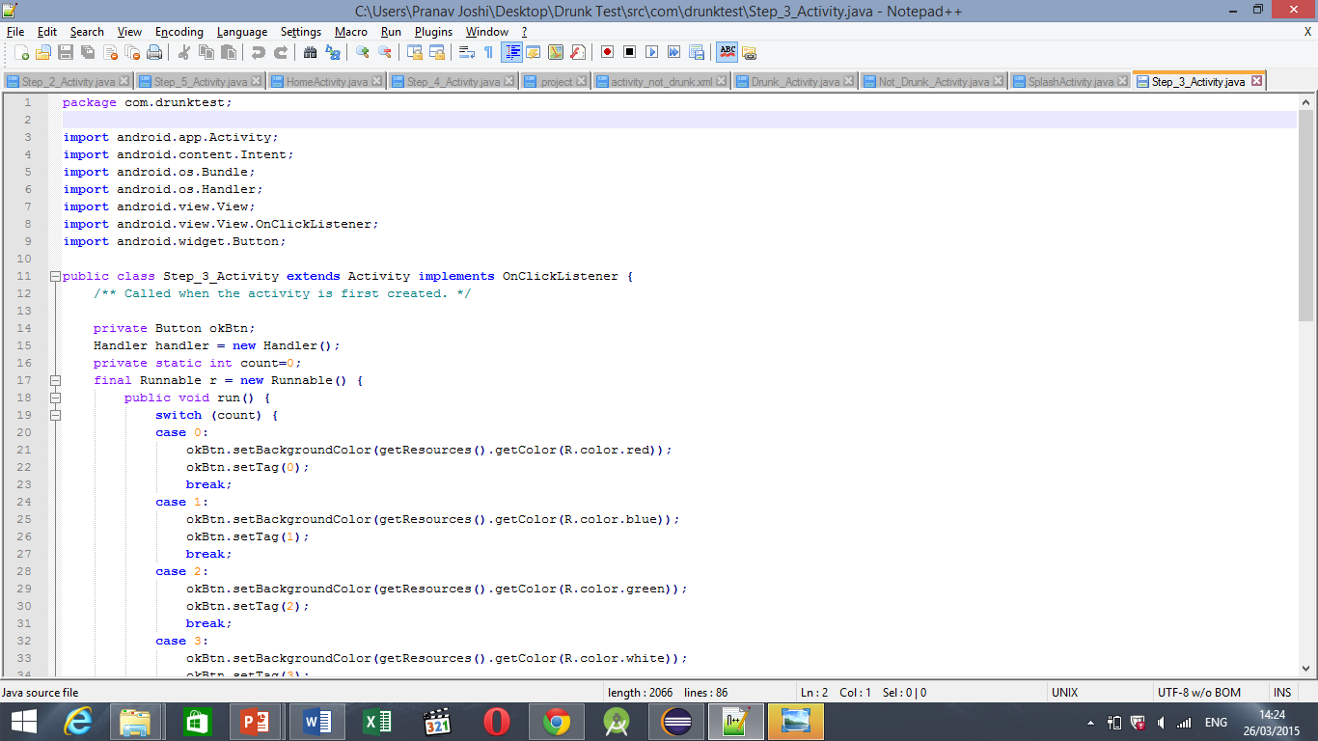

Slide 20
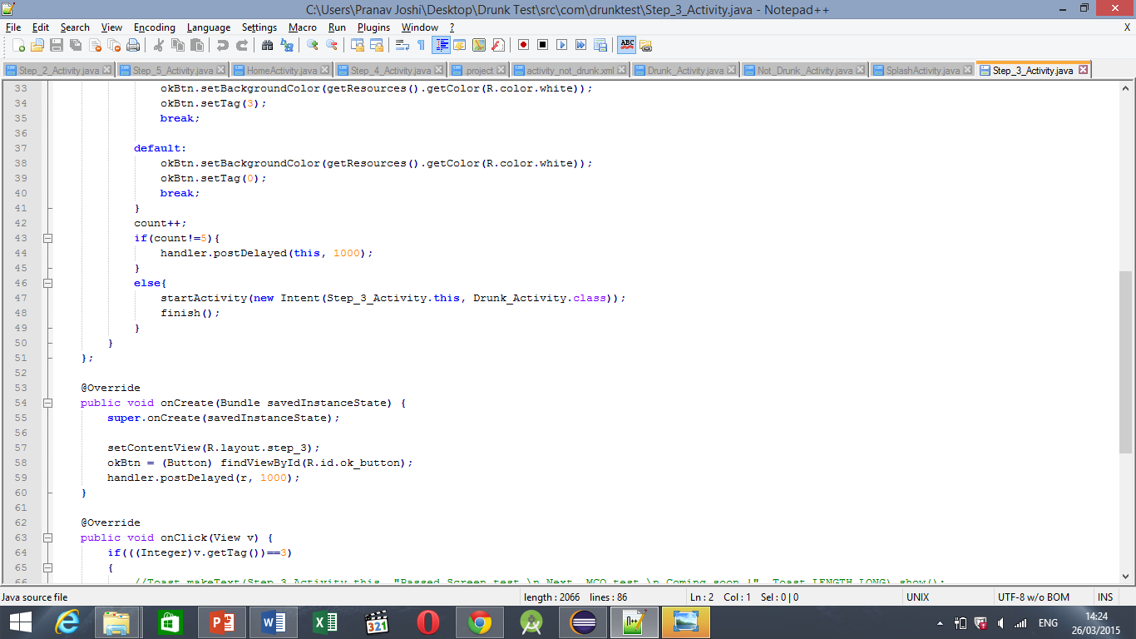

Slide 21
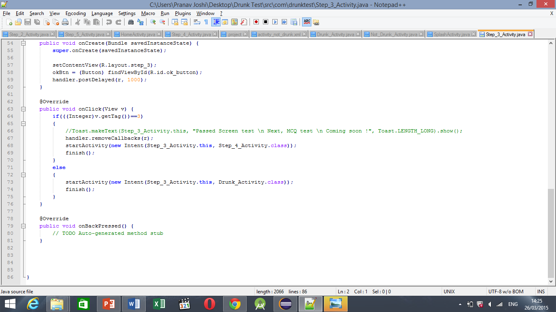

Slide 22
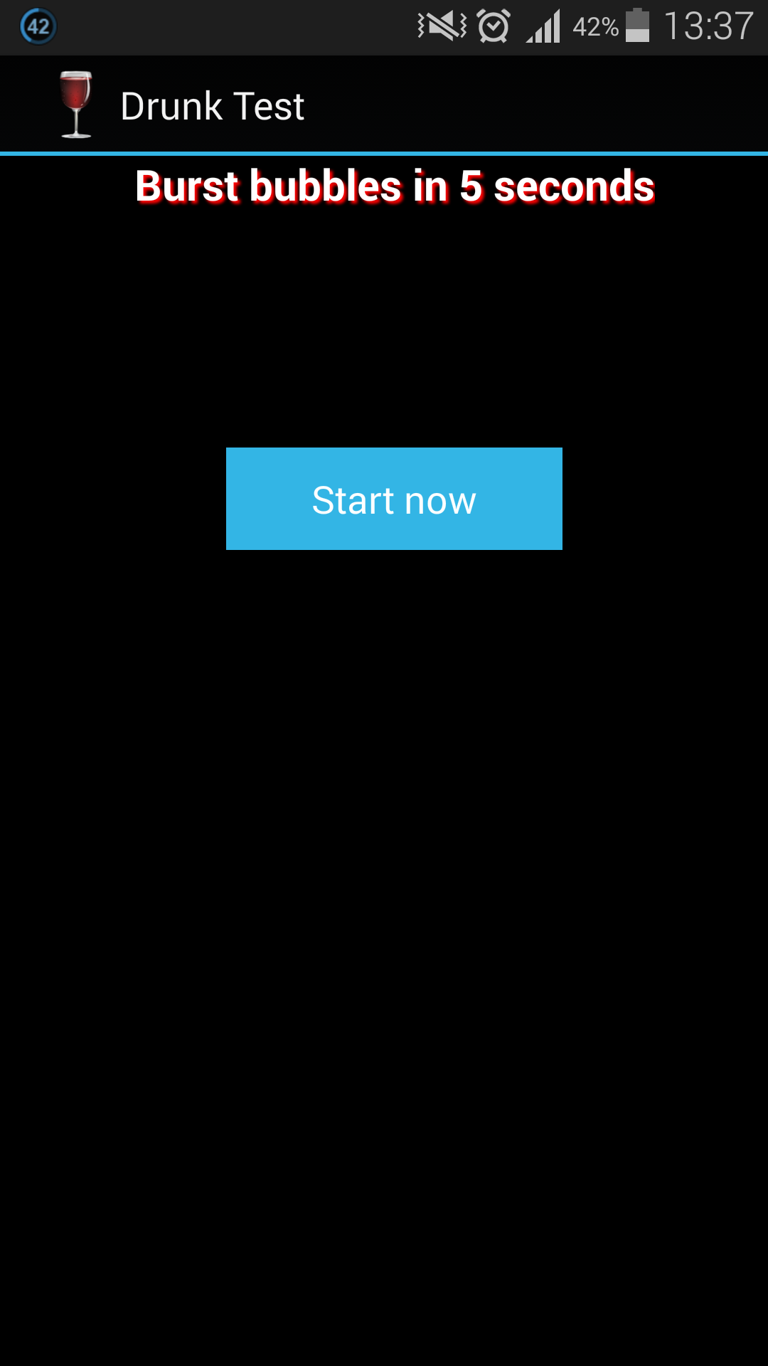
Screen 4, Activity 4, test 3. checking the speed Test. In 5 seconds , the said person is supposed to burst 5 bubbles.

Slide 23
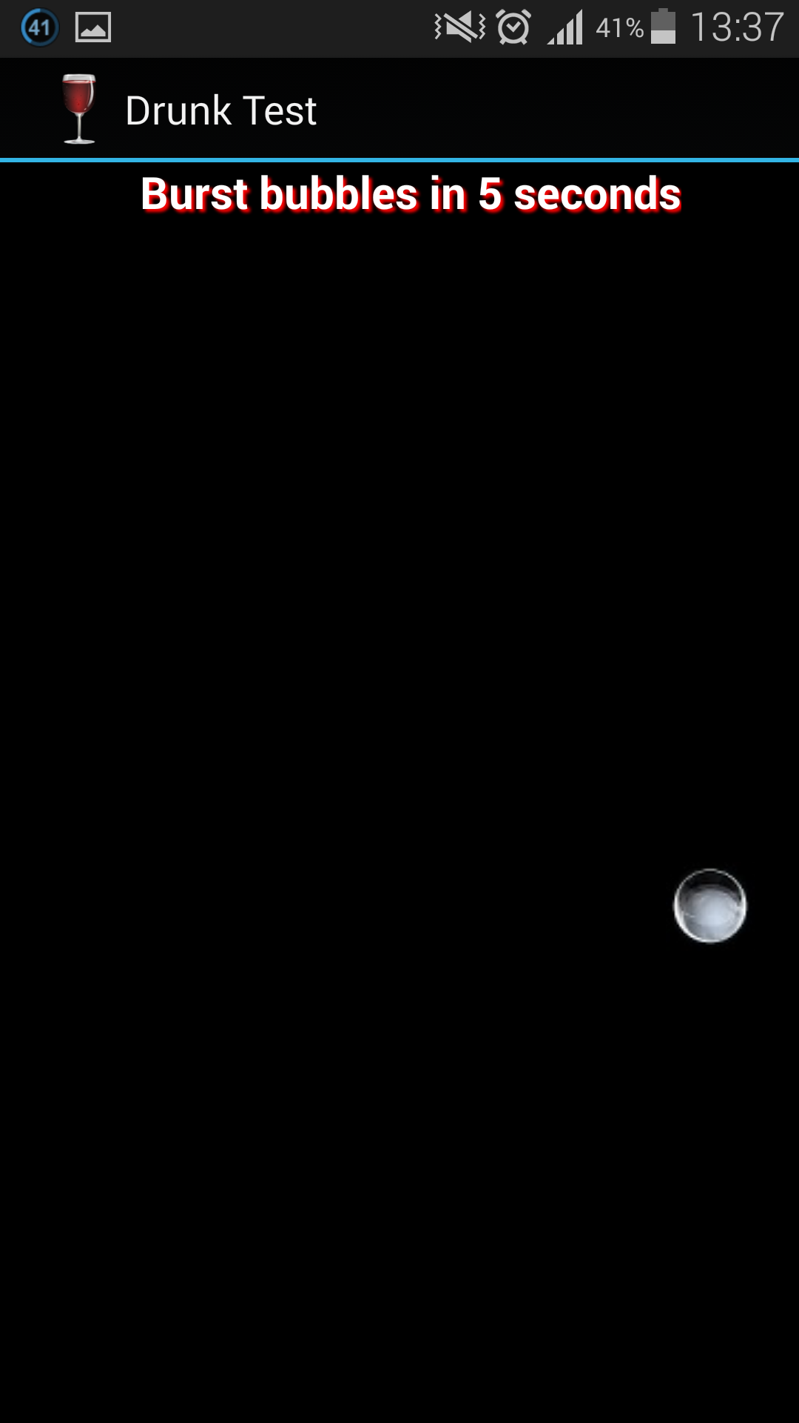
The code is using visible invisible scheme for making this work. As soon as the user presses the bubble, counter is increased and the invisible() code is run. The bubble which is just tapped becomes invisible.

Slide 24
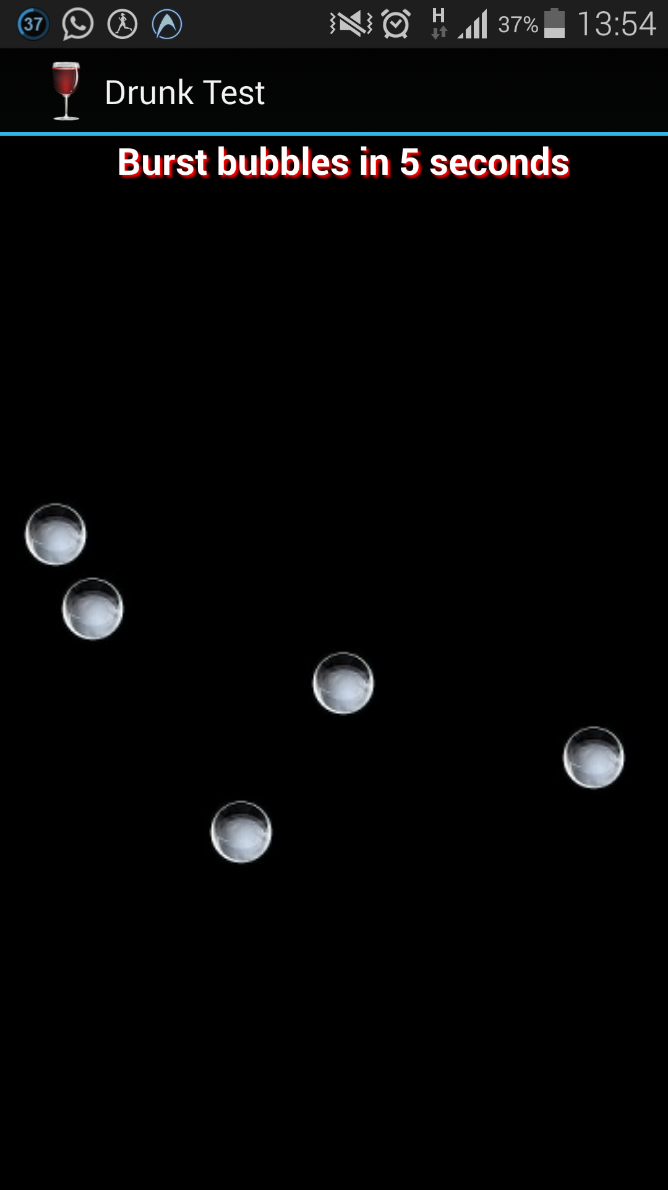
STARTING Screen

Slide 25
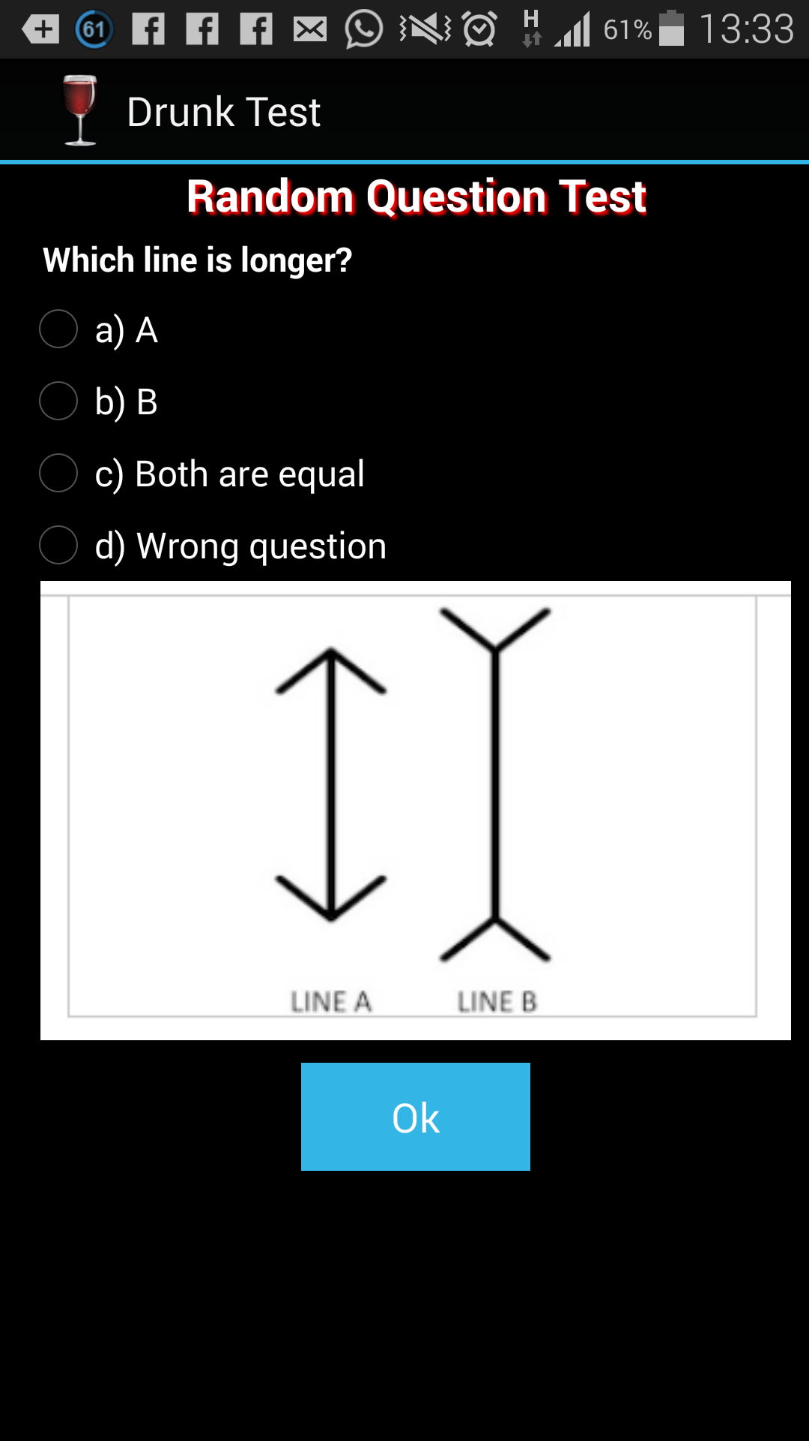
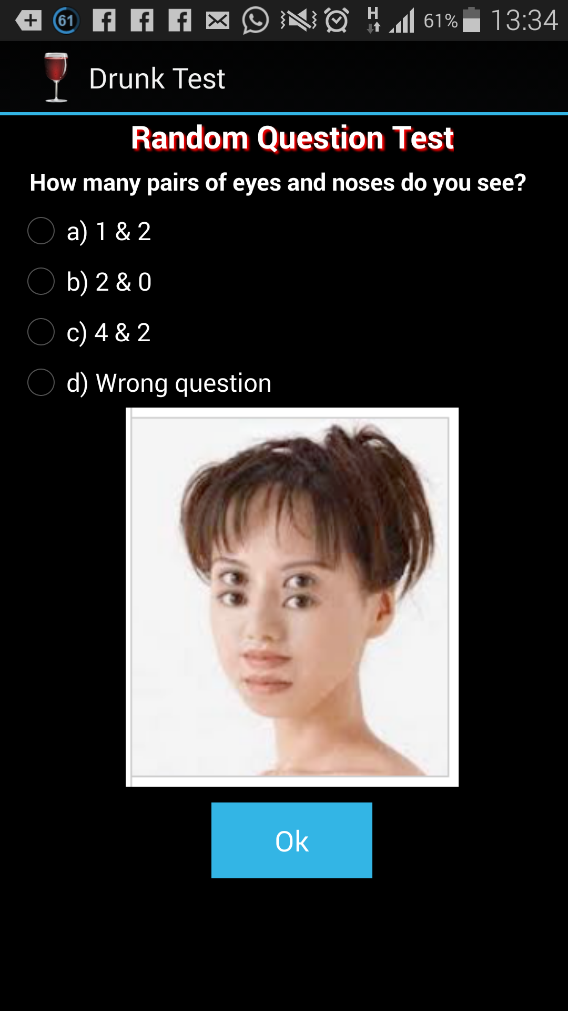

Slide 26
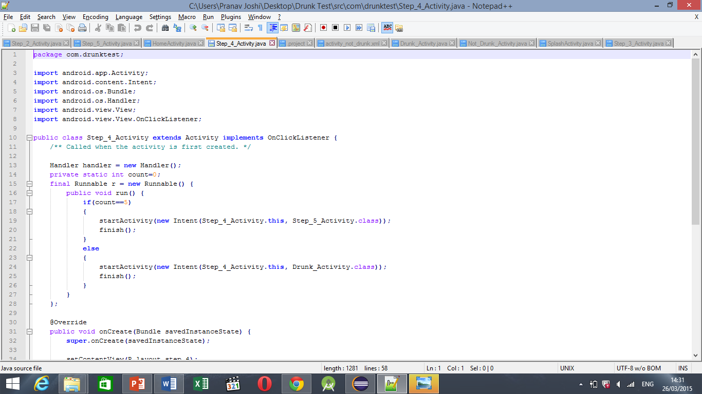
+

Slide 27
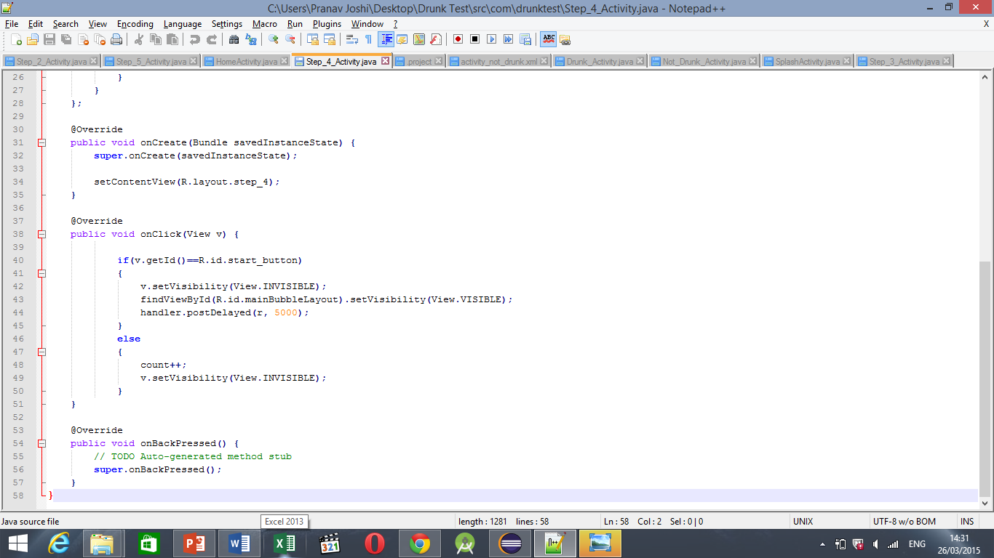

Slide 28
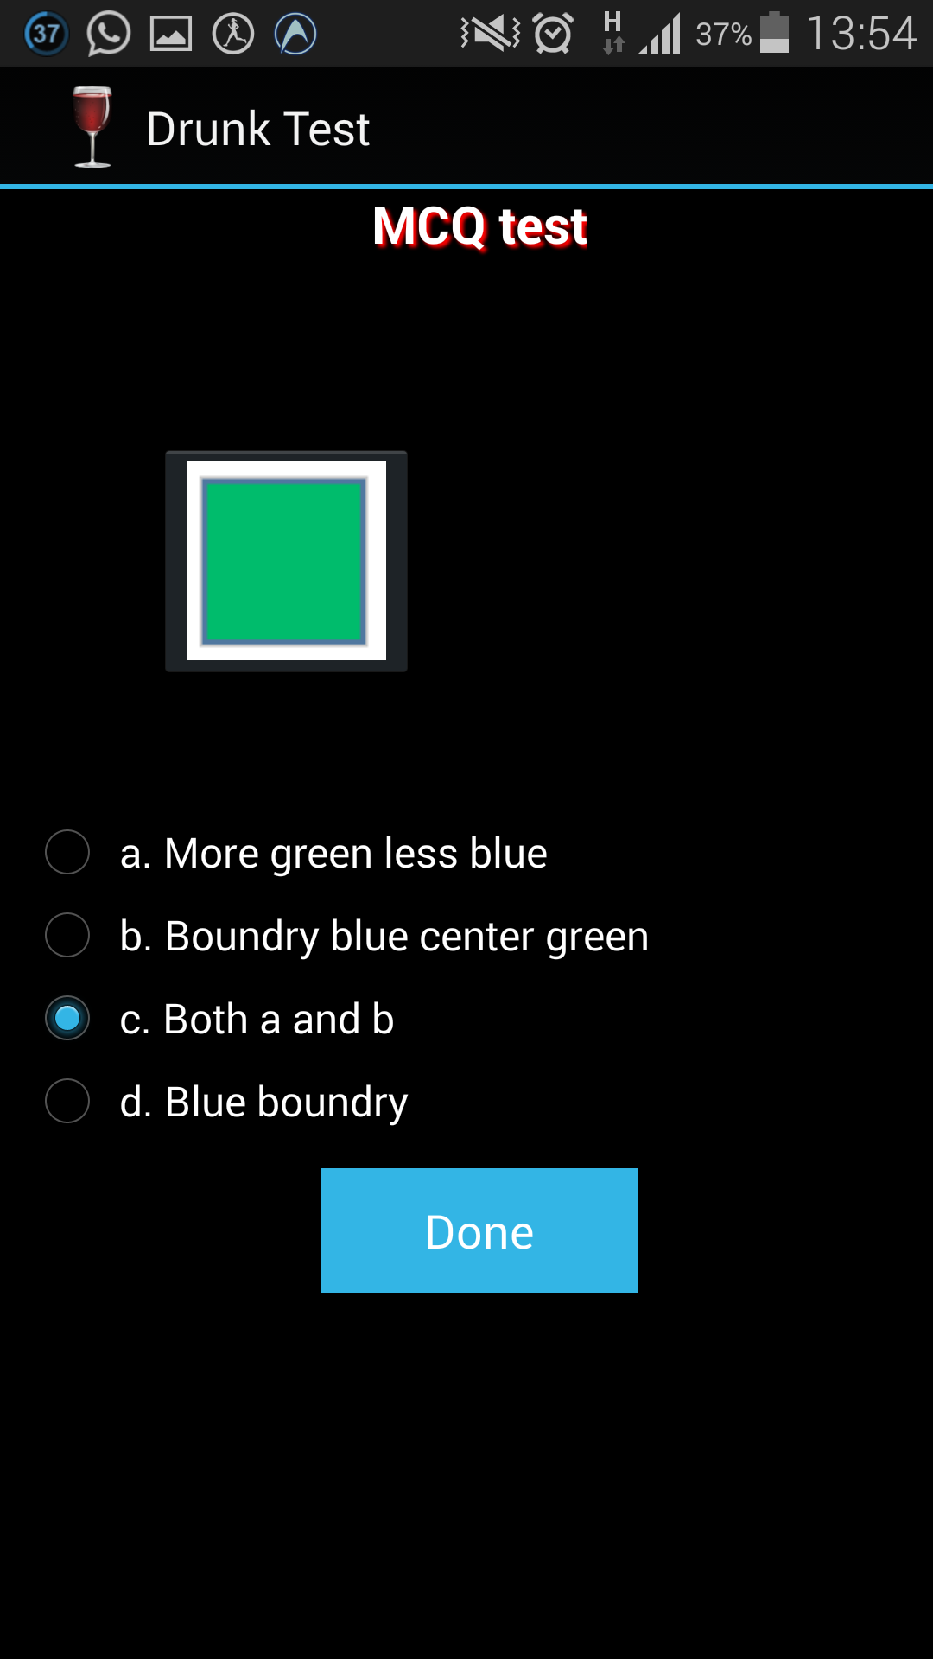
Screen 5, Activity 5, and test 4. IMAGE VISIbility and color identification test

Slide 29
The image specifically involves 3 colours which are In unequal proportion. This is a deliberate exercise to challenge the user’s observational skills. By studying various reports of psychologists on indicative behaviours and cognitive impulses, this extra page was thought about. The thin Blue border is just visible to an individual with no alcohol content. But those who are inebriated might be able to spot the green centre but fail to recognise the blue exterior. Again, the options are confusing. The screening question hints on the fact that even though it seems repetitive, alcohol intake may vary and hence behaviour may too.

Slide 30
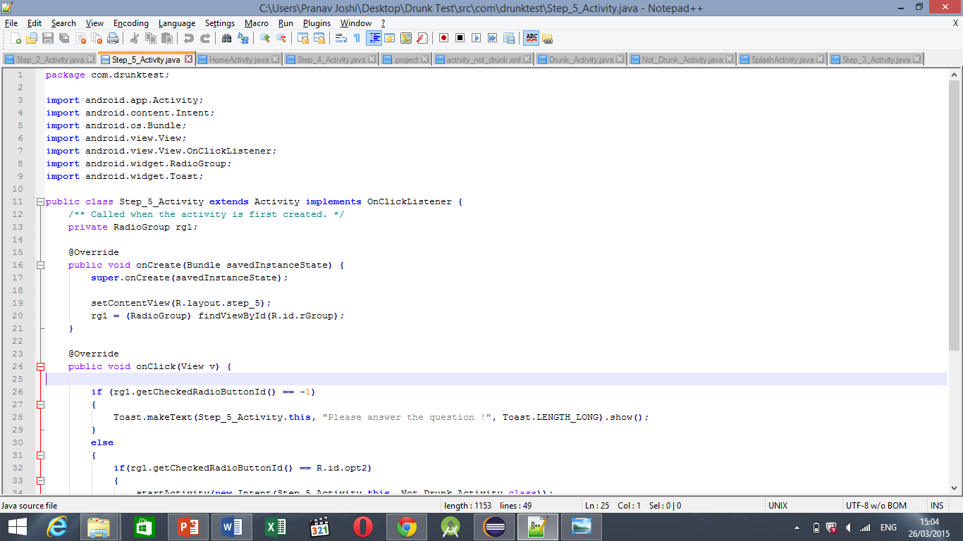

Slide 31
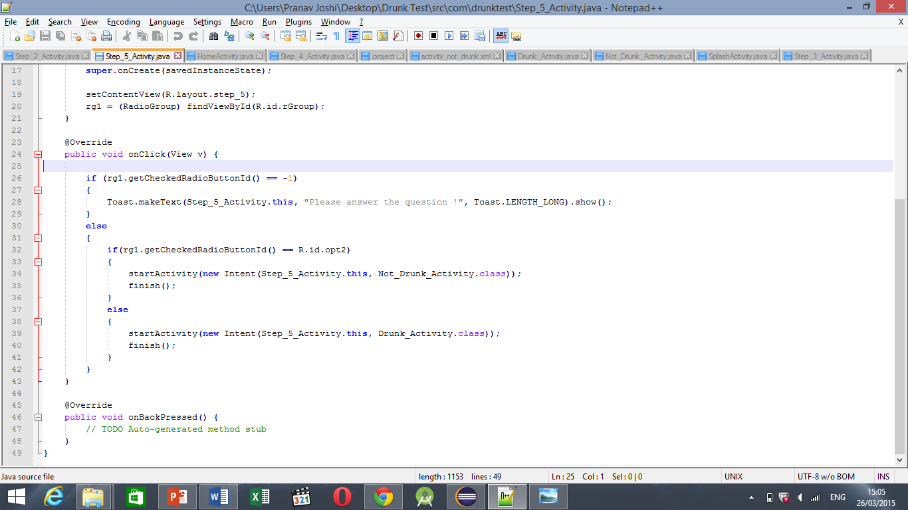

Slide 32
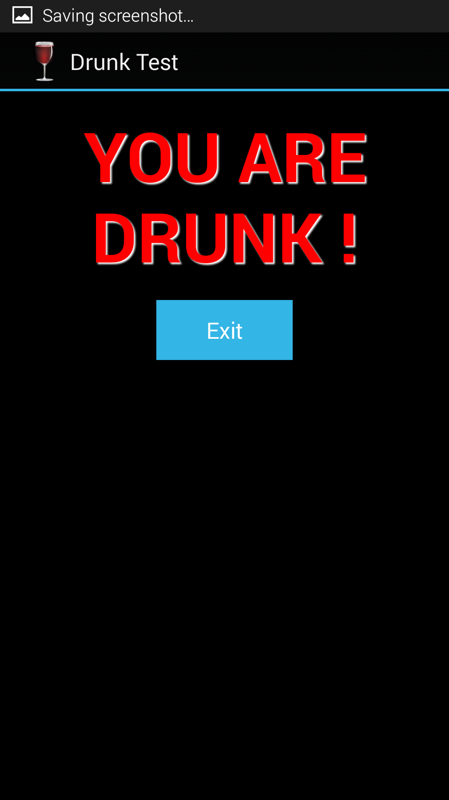
RESULTS PAGE Negative Result

Slide 33
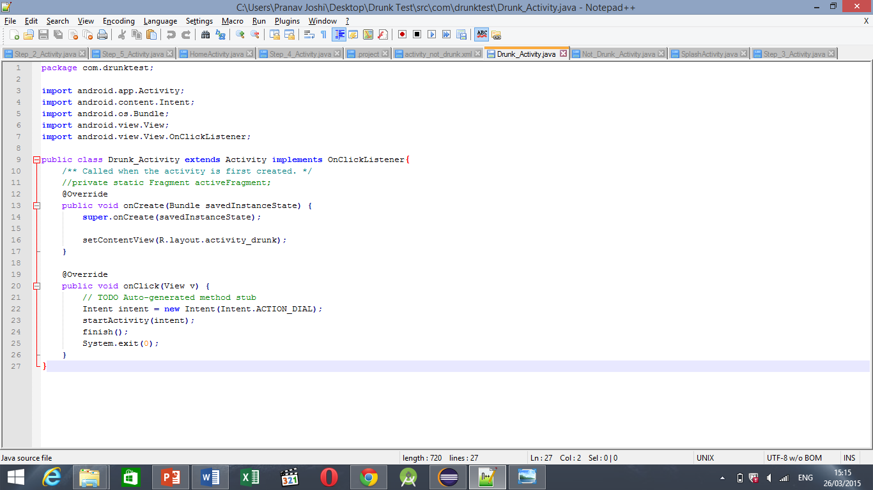

Slide 34
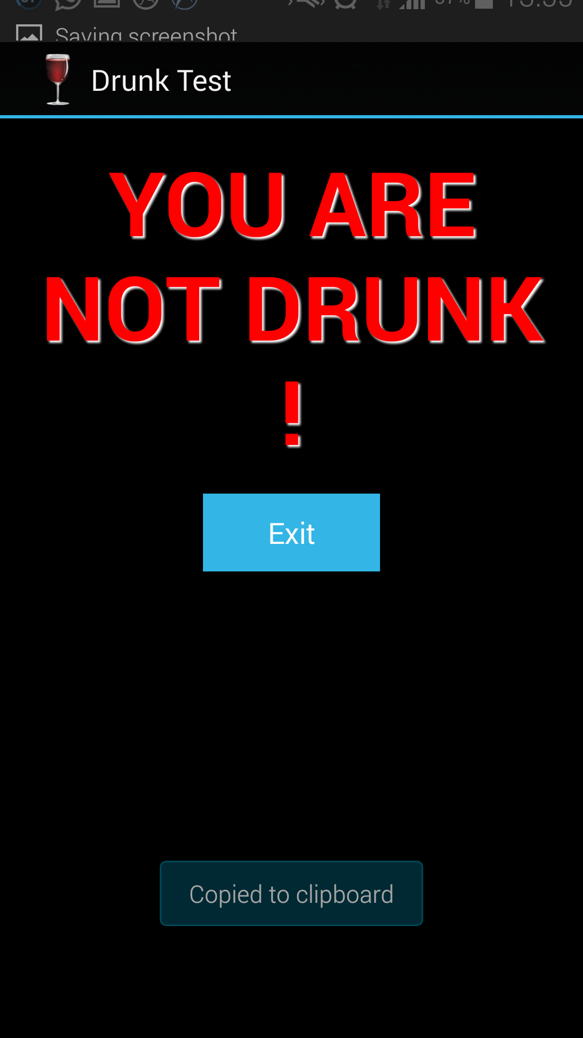
RESULTS PAGE Positive Result

Slide 35
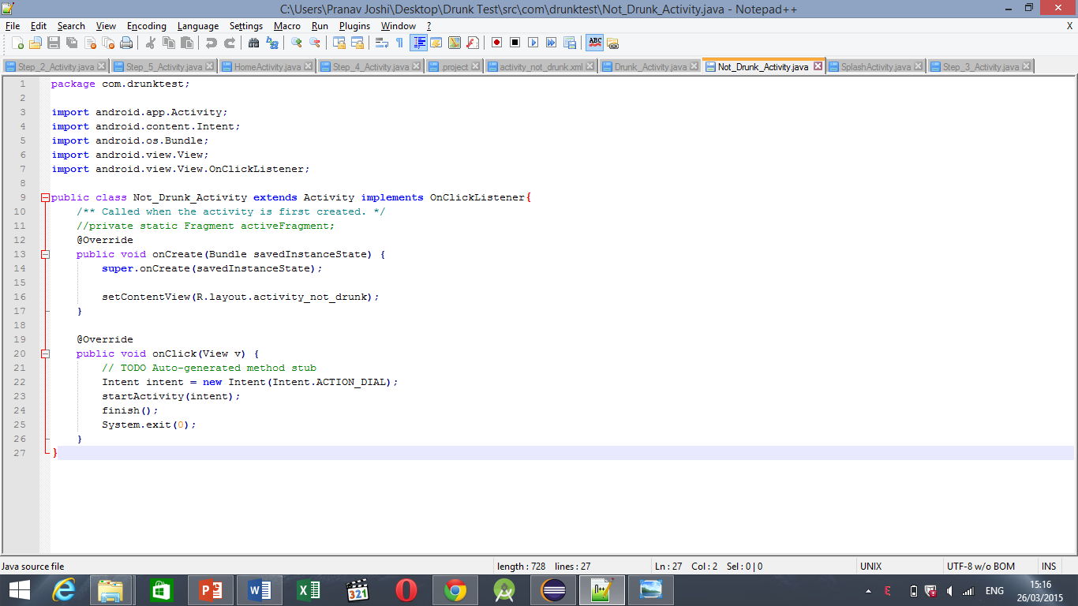

Slide 36
FINISH THANK YOU Abhinav Jaiswal (b043) Vedant Sharma (B044) PRANAV JOSHI (B046) PRAGTI KAPOOR(B049)

